Slide 1



@QMBCI
bartscancerinstitute
Mapping the LIMD1-ARIH1 Interaction with Recombinant LIMD1 Truncations
Eylul Turkay
MSc Cancer and Molecular and Cellular Biology
Barts Cancer Institute
Queen Mary University of London
Supervisors: Professor Dr Tyson V. Sharp and Dr Kunal Shah
Notes:
Good afternoon. This project investigated which region of the tumour suppressor LIMD1 associates with the E3 ubiquitin ligase ARIH1. I generated a panel of recombinant LIMD1 fragments, assessed their expression and purification, and used selected fragments in pull-down experiments to test whether ARIH1 recovery could be mapped to a specific region.
[Sources]
Turkay, E. 2026, MSc dissertation, Abstract and pages 18 to 47.

Slide 2
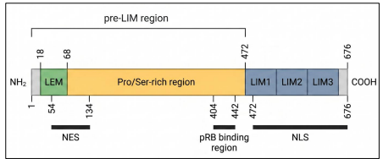
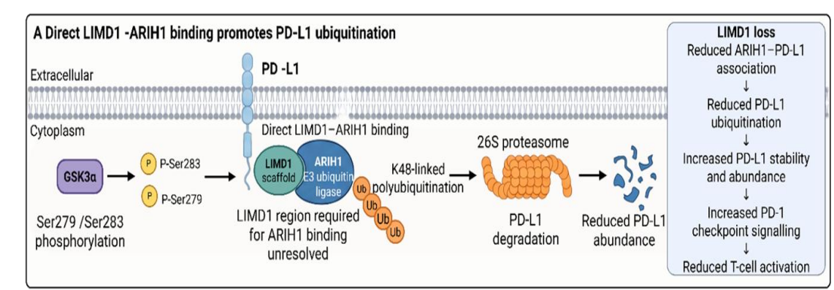
Background
LIMD1 loss stabilises PD-L1
LIMD1: 676-aa scaffold protein
LIMD1-ARIH1 supports PD-L1 turnover
Notes:
LIMD1 is a 676 amino acid scaffold protein encoded at chromosome 3p21.3. It contains a pre-LIM region and three C-terminal LIM domains.
In the TRACERx cohort, LIMD1 loss was clonal in more than 80 percent of lung squamous cell carcinomas and around 40 percent of lung adenocarcinomas, indicating that it commonly occurs early.
[Point to the pathway]
LIMD1 supports ARIH1-dependent ubiquitination and degradation of PD-L1. LIMD1 loss can therefore stabilise PD-L1 and suppress anti-tumour T-cell activity. Mapping the ARIH1-associated region could help explain this route to immune evasion in lung cancer.
[Sources]
Shah et al. 2026, Life Science Alliance, volume 9, issue 10.
Turkay, E. 2026, MSc dissertation, pages 1 to 6.

Slide 3
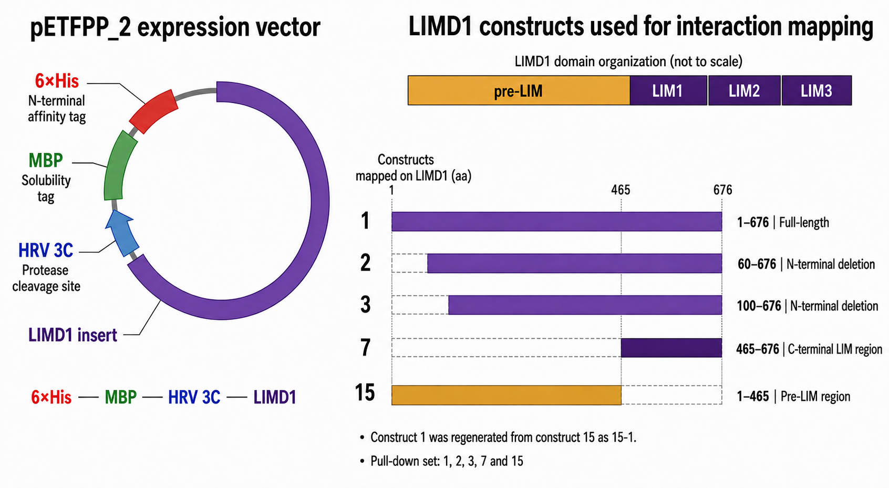
The LIMD1 region required for ARIH1 binding remains unresolved
Notes:
Previous work supports an association between full-length LIMD1 and ARIH1, but the responsible region remains unknown.
[Point to the selected constructs]
Construct 1 is full-length LIMD1. Constructs 2 and 3 contain residues 60 to 676 and 100 to 676. Construct 7 contains the LIM domains, while Construct 15 represents the pre-LIM region.
Constructs 2 and 3 test whether the first 99 residues are required. Constructs 7 and 15 provide a broad comparison between the LIM-domain and pre-LIM regions. Any candidate would require validation within full-length LIMD1.
[Sources]
Turkay, E. 2026, MSc dissertation, pages 4 to 7.

Slide 4
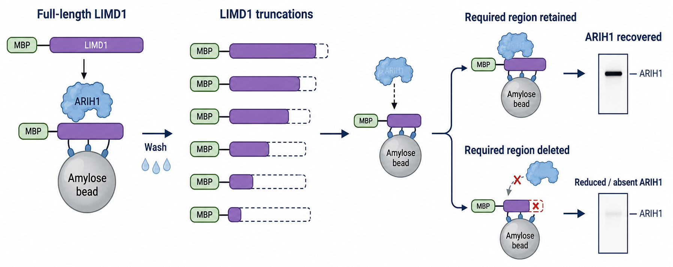
Aims and Hypothesis
ARIH1 binds a defined region of LIMD1.
Deleting that region will reduce or abolish ARIH1 recovery in LIMD1-directed pull-downs.
Aim 1: Validate the LIMD1 construct panel.
Aim 2: Optimise expression and purification to recover comparable, intact bait.
Aim 3: Compare ARIH1 recovery across suitable LIMD1 truncations.
Notes:
The hypothesis was that ARIH1 associates with a defined region of LIMD1. Removing that region should reduce ARIH1 recovery. This requires intact proteins at comparable levels.
Of the 24 planned constructs, Constructs 18, 20, 21 and 24 were unavailable and were not investigated.
The aims were to validate the available panel, assess expression, optimise purification and compare ARIH1 recovery using suitable truncations. The final set was selected after assessing recovery.
[Sources]
Turkay, E. 2026, MSc dissertation, pages 7 to 18.

Slide 5
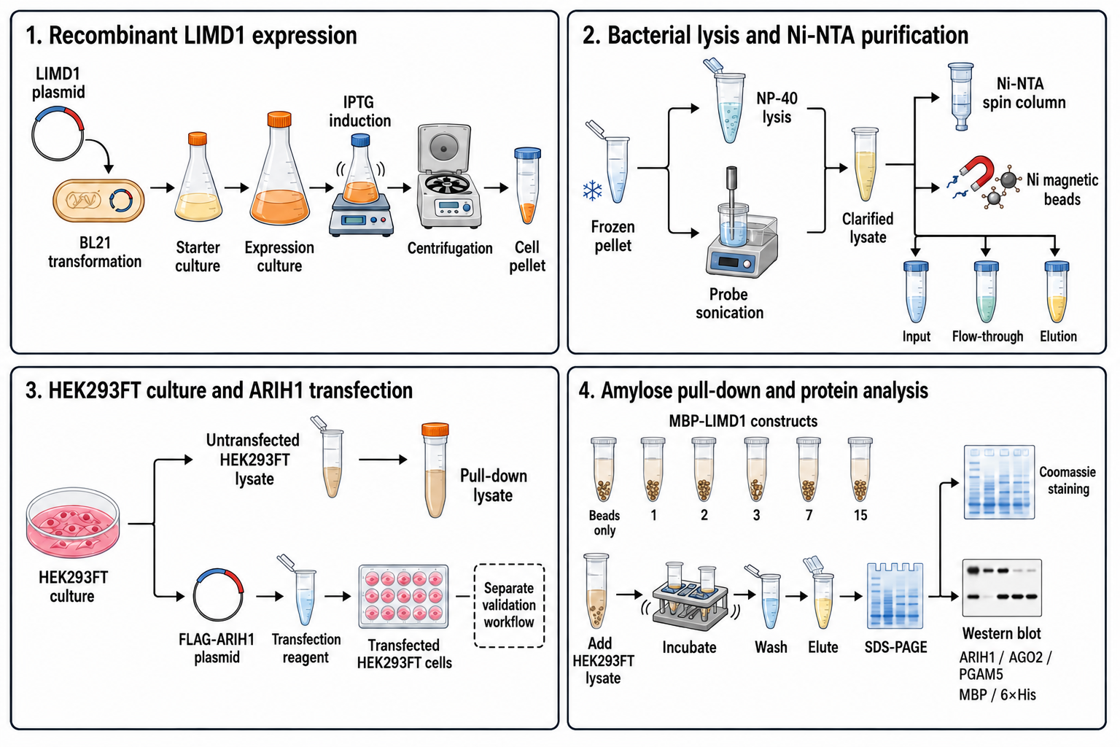
Methods
Experimental workflow
Notes:
Sequence-verified plasmids were expressed in BL21 bacteria. Each protein carried a His tag for nickel purification and an MBP tag for amylose capture and detection.
[Follow the workflow]
After lysis and purification, selected LIMD1 proteins were immobilised on amylose beads and incubated with HEK293FT lysate containing endogenous ARIH1. Bound proteins were then analysed by immunoblotting.
FLAG-ARIH1 was generated for a reciprocal experiment, but its protein expression was not established and the pull-down was not completed. The conclusions therefore rely on the LIMD1-directed experiment.
[Sources]
Turkay, E. 2026, MSc dissertation, methods and Figure 2.2.

Slide 6
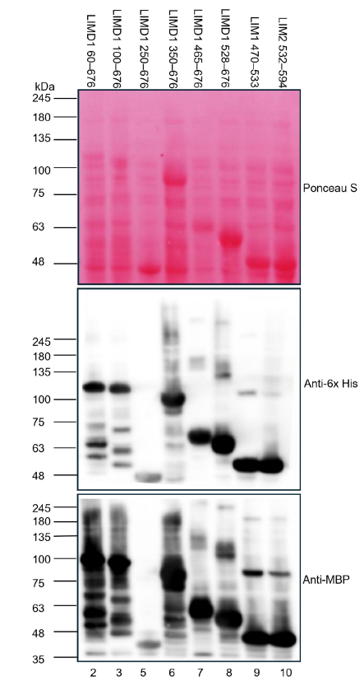
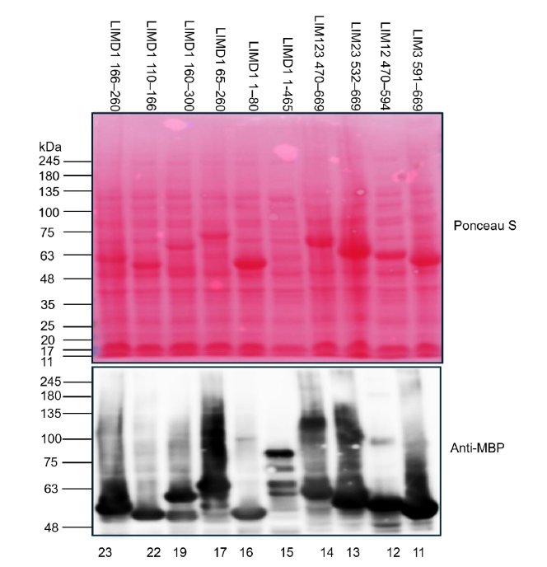
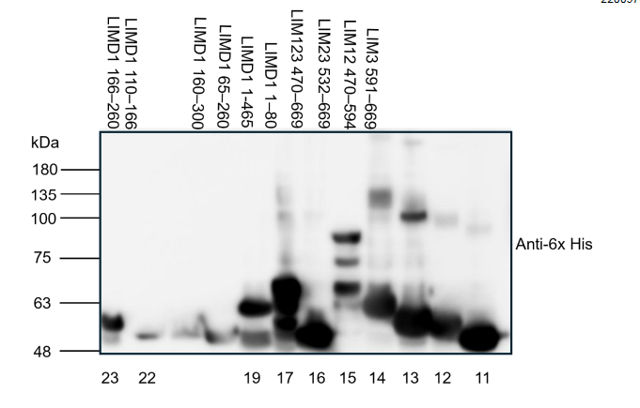
Results
Tagged LIMD1 expression showed variable band patterns
Notes:
This slide shows LIMD1 construct expression in BL21 cells before purification. Anti-His and anti-MBP detected tagged products across the panel, although the patterns varied.
Most constructs produced bands near their expected masses. Construct 5 mainly produced a smaller product. Construct 15 produced several bands, while Construct 22 showed comparatively weak expression.
Overall, the constructs were expressed, but purification was needed to assess the recovery and integrity of each protein.
[Sources]
Turkay, E. 2026, MSc dissertation, pages 20 to 23.

Slide 7
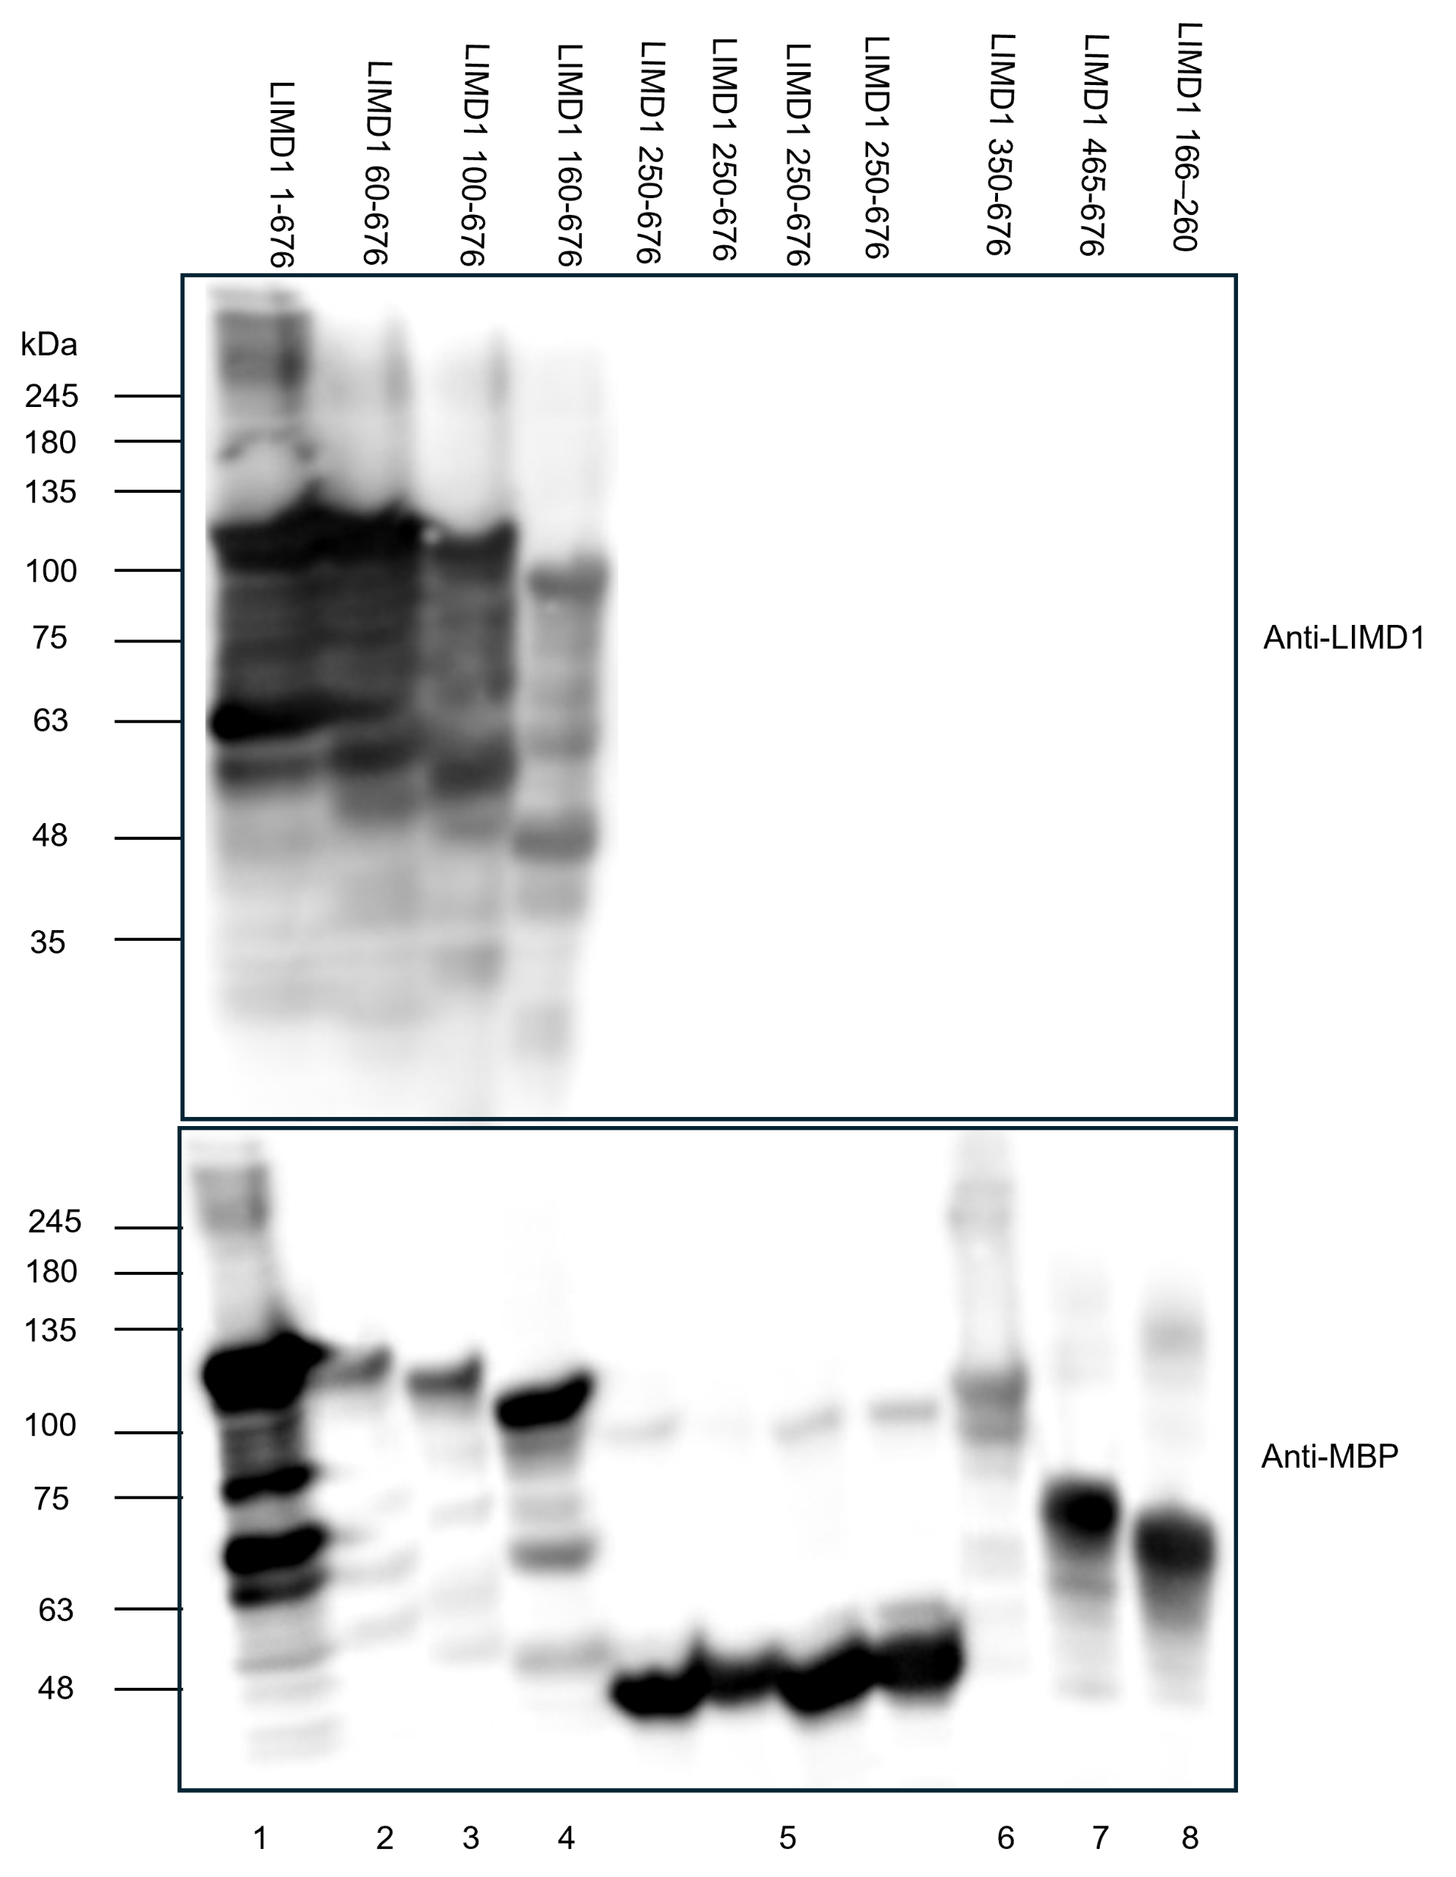
Full-length LIMD1 migrated near 117 kDa; Construct 5 predominantly migrated below 55 kDa
Notes:
Full-length LIMD1 was regenerated from Construct 15 by site-directed mutagenesis and designated Construct 1.
[Point to Construct 1]
Construct 1 produced anti-MBP and anti-LIMD1 signals near its expected mass of 117 kilodaltons, consistent with the full-length fusion protein.
[Point to Construct 5]
Construct 5 mainly produced MBP-reactive bands between 48 and 55 kilodaltons, well below its expected mass of 90 kilodaltons. Most of the detected protein was therefore shortened, which supported excluding Construct 5 from the final pull-down.
[Sources]
Turkay, E. 2026, MSc dissertation, pages 24 to 26.

Slide 8
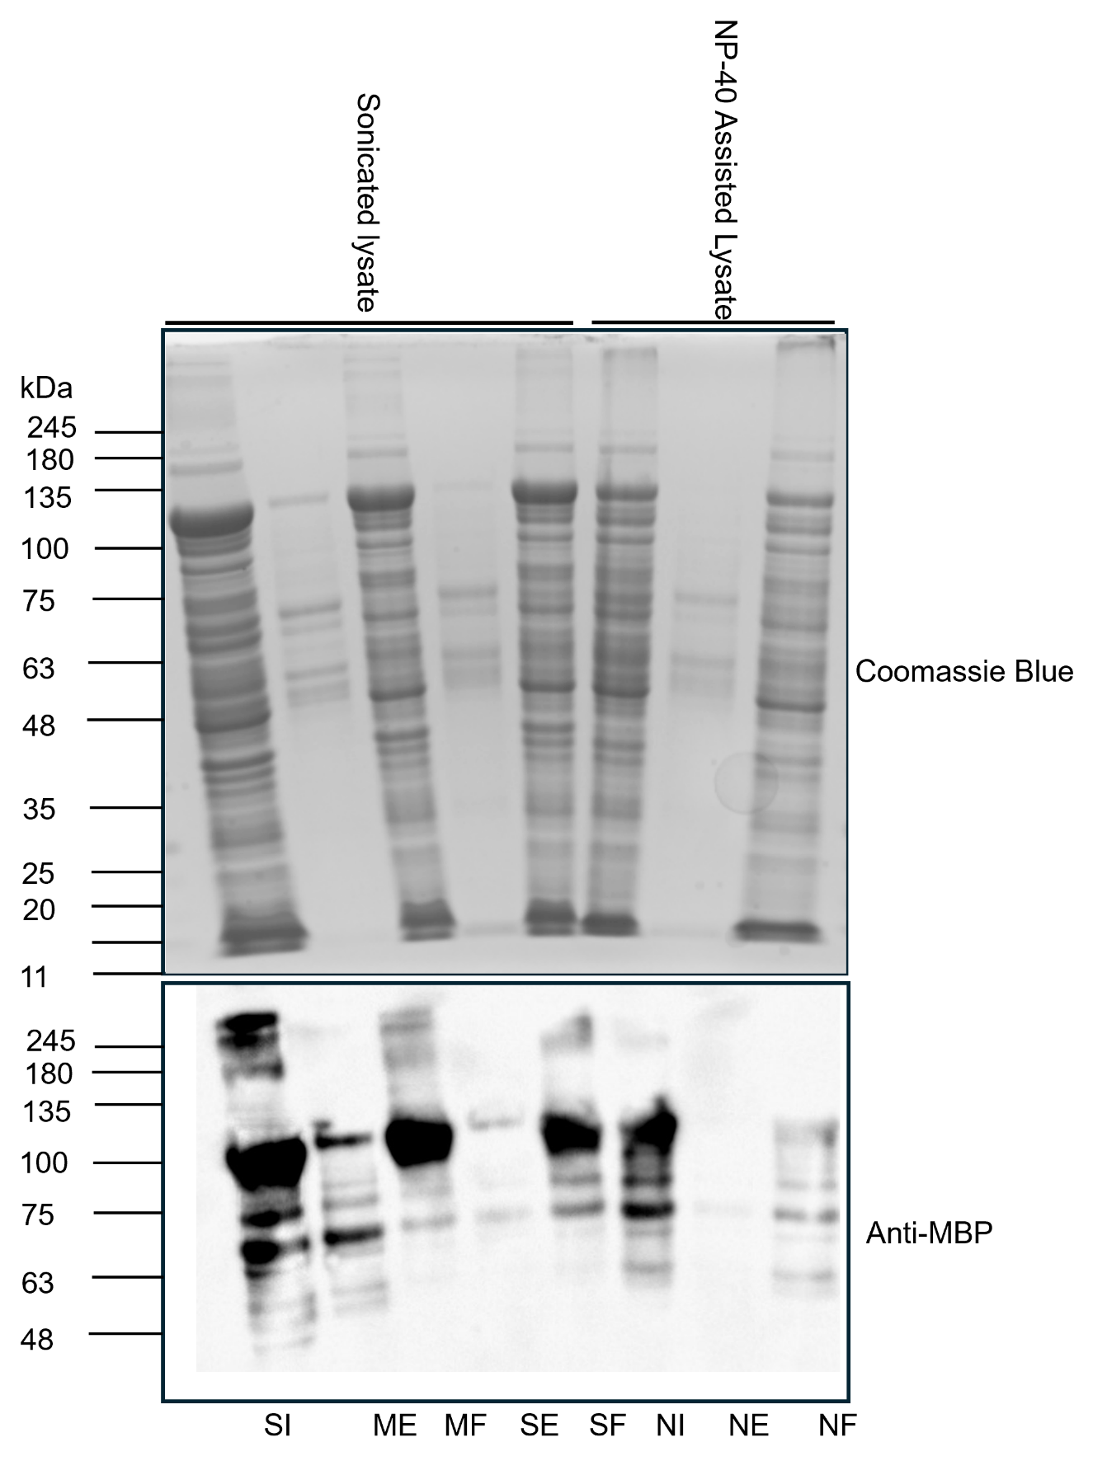
Sonication increased elution recovery, but tagged protein remained unbound
Notes:
I compared NP-40-assisted lysis with sonication. SI represents sonicated input, ME magnetic-bead elution and MF magnetic-bead flow-through.
[Point to the anti-MBP blot]
Full-length LIMD1 was detected near 117 kilodaltons in both inputs. Sonication produced greater elution recovery than NP-40 and was selected. Tagged protein remained in the flow-through, showing incomplete capture. Magnetic beads were therefore tested for constructs that performed poorly with spin columns.
[Sources]
Turkay, E. 2026, MSc dissertation, pages 30 to 32.

Slide 9
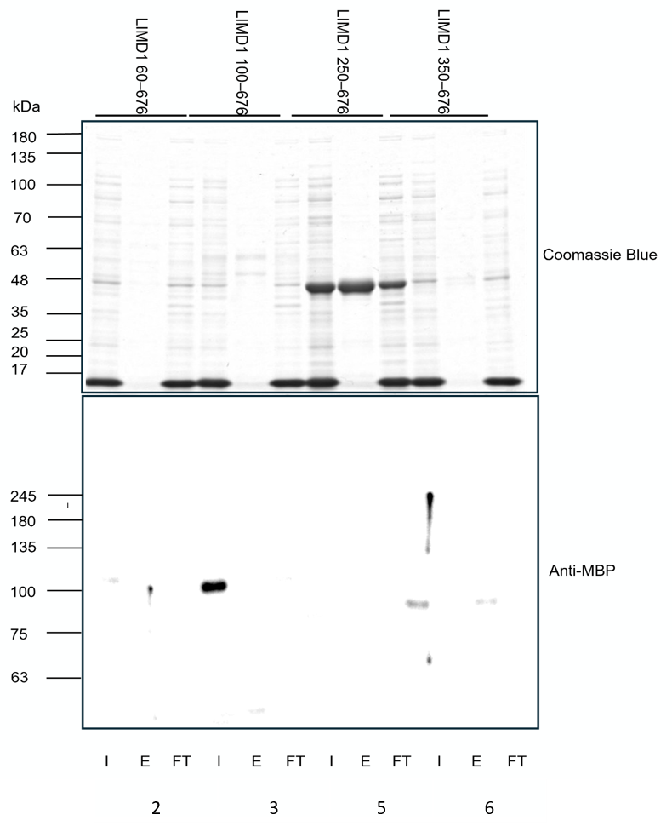
Constructs 2 and 3 showed weak elution recovery after Ni-NTA purification
Notes:
Here, I represents input, E represents elution and FT represents flow-through.
[Point to Constructs 2 and 3]
Constructs 2 and 3 were present in the input but weak in the spin-column elution. This indicates poor recovery rather than absent expression.
Construct 5 produced a strong Coomassie band below its expected mass without a corresponding MBP signal, indicating that it was not the intended fusion protein. These results supported testing magnetic beads.
[Sources]
Turkay, E. 2026, MSc dissertation, pages 28 and 29.

Slide 10
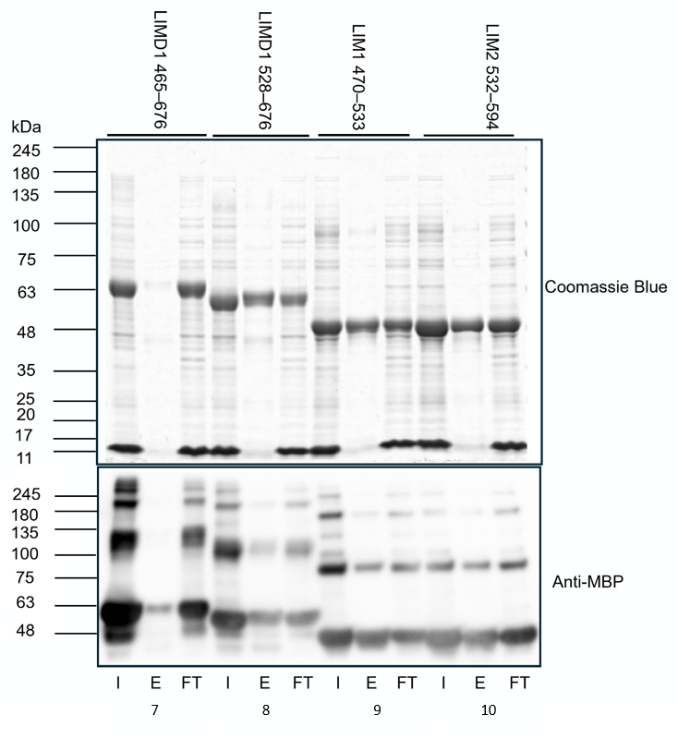
Constructs 8–10 were recovered in elution, whereas
Construct 7 recovery was weak
Construct | Expected mass (kDa)
7 | 66.6
8 | 59.7
9 | 50.3
10 | 50.2
Notes:
[Point to Construct 7]
Construct 7 was present in the input but recovered only weakly in the spin-column elution.
[Point to Constructs 8 to 10]
Constructs 8 to 10 produced clearer elution bands near their expected masses. Recovery therefore depended on the LIMD1 fragment rather than the shared His tag alone.
Construct 7 was retained because it contained the complete LIM-domain region required for the broad mapping comparison.
[Sources]
Turkay, E. 2026, MSc dissertation, pages 28 and 31.

Slide 11
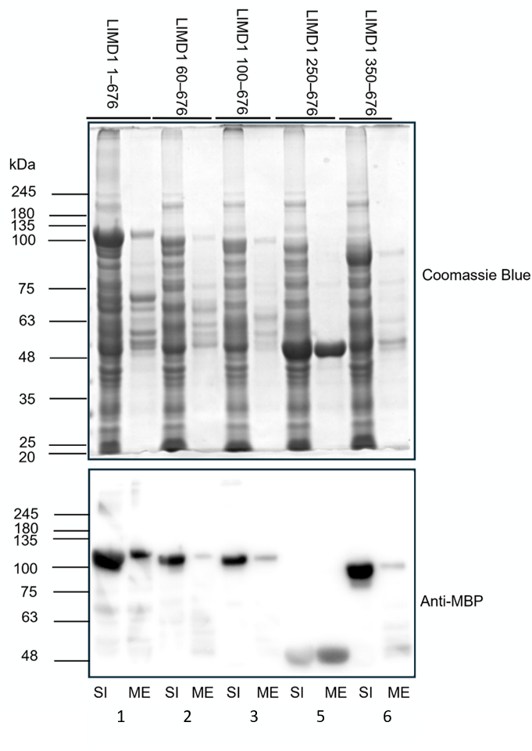
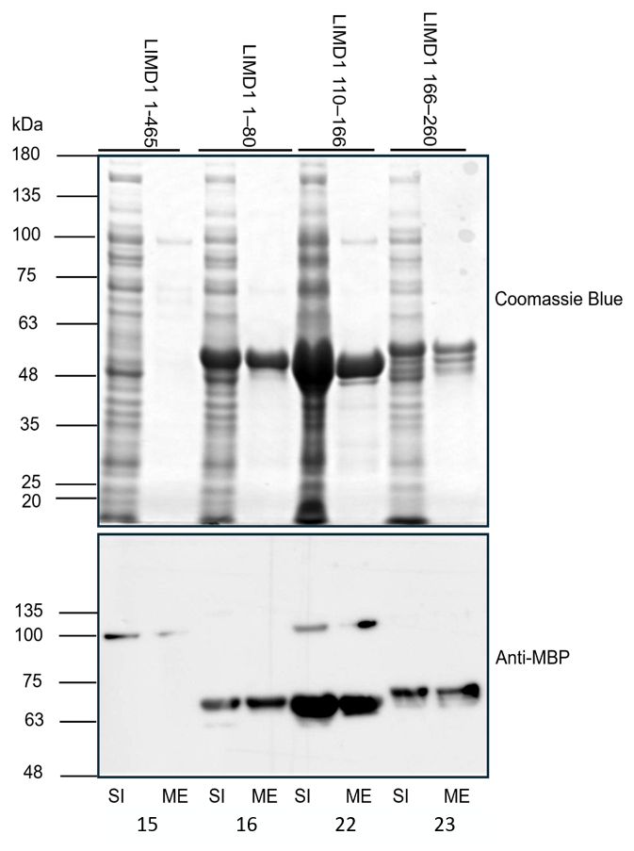
Magnetic nickel beads recovered the core baits with unequal yields
Notes:
Magnetic beads recovered Constructs 1, 2, 3 and 15, although their yields remained unequal. These elutions were retained for the final pull-down.
Construct 5 produced a strong MBP signal, but its main product was smaller than expected. It was excluded because intact bait had not been demonstrated.
Construct 7 was not tested with magnetic beads, so its available spin-column preparation was used in the final assay.
[Sources]
Turkay, E. 2026, MSc dissertation, pages 33 to 35.

Slide 12
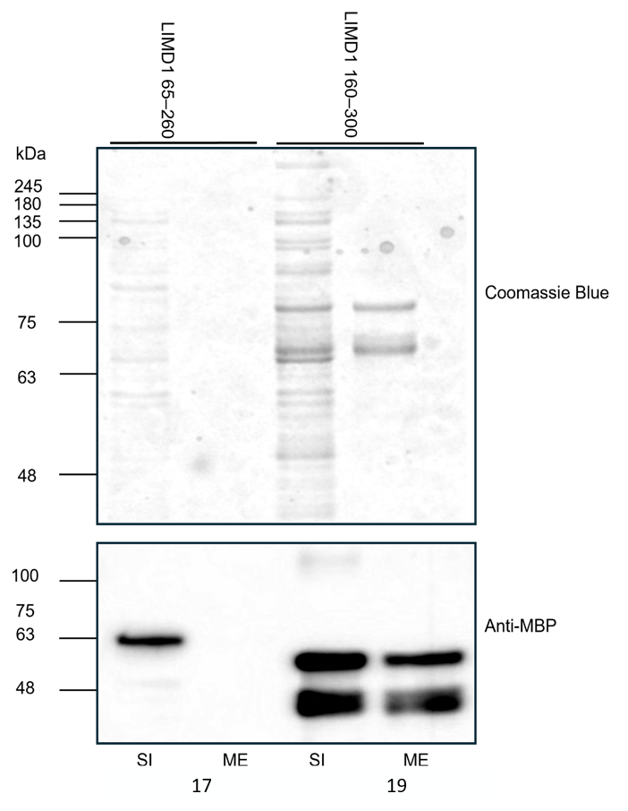
Construct 17 was detected before purification but not in the recovered fraction
Notes:
Construct 17 was present in the input but was not detected in the magnetic-bead elution. Construct 19 was recovered.
Construct 17 could have refined the pre-LIM comparison, but it was excluded because purified bait was not demonstrated. This does not show that Construct 17 cannot associate with ARIH1.
The final bait panel therefore consisted of Constructs 1, 2, 3, 7 and 15.
[Sources]
Turkay, E. 2026, MSc dissertation, pages 33 to 36.

Slide 13
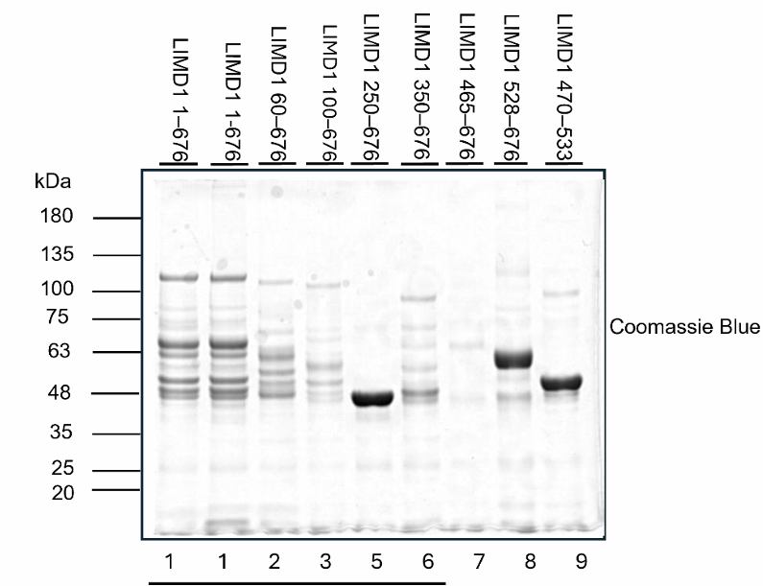
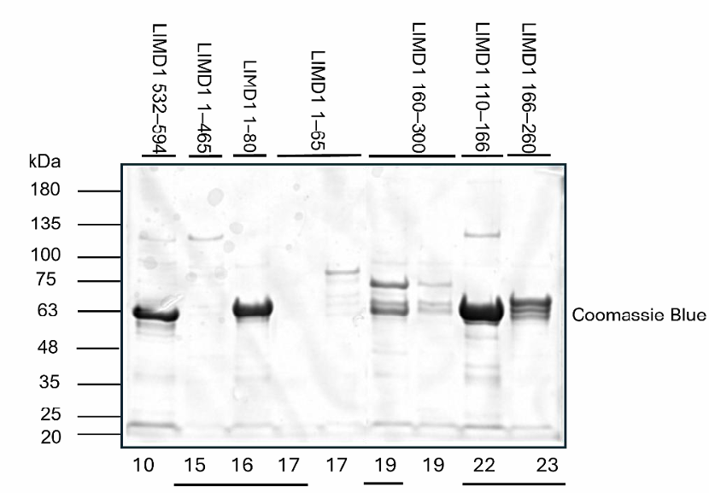
Equal elution volumes would not provide equal amounts of intact LIMD1
Notes:
This gel compares the purified LIMD1 preparations. Underlined samples were purified using magnetic beads, while the remaining samples were obtained using spin columns.
[Point to Constructs 1, 2, 3, 7 and 15]
These five constructs were used in the final pull-down, but they contained unequal amounts of intact LIMD1.
Twenty microlitres of each preparation was used, but equal volume does not provide equal bait. ARIH1 recovery could therefore reflect bait availability rather than binding strength. This is the main technical limitation.
[Sources]
Turkay, E. 2026, MSc dissertation, page 37 and pages 41 to 43.

Slide 14
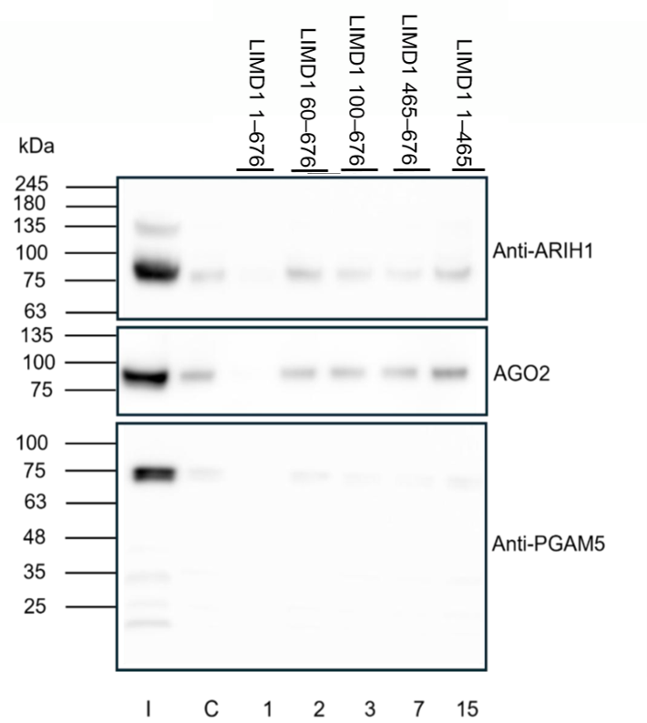
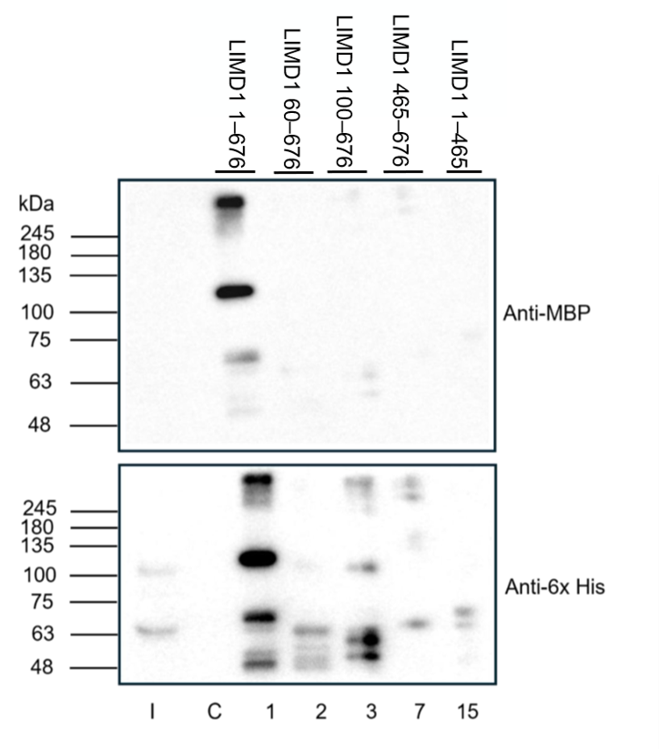
Weak ARIH1 signals overlapped with bead background, while bait recovery differed
Notes:
This is the LIMD1-directed pull-down using untransfected HEK293FT lysate. I represents the lysate input and C represents the bead-only control.
[Point to the ARIH1 panel]
ARIH1 was detected in the input, but weak signals also appeared in the bead-only control and construct lanes. No construct showed clear enrichment above background.
[Point to the MBP and His panels]
Bait recovery varied markedly. Differences in ARIH1 signal could therefore reflect unequal bait rather than different binding.
AGO2 and PGAM5 also showed no construct-selective enrichment. Under these conditions, no ARIH1-associated LIMD1 region could be assigned or excluded.
[Sources]
Turkay, E. 2026, MSc dissertation, pages 38 to 43.

Slide 15
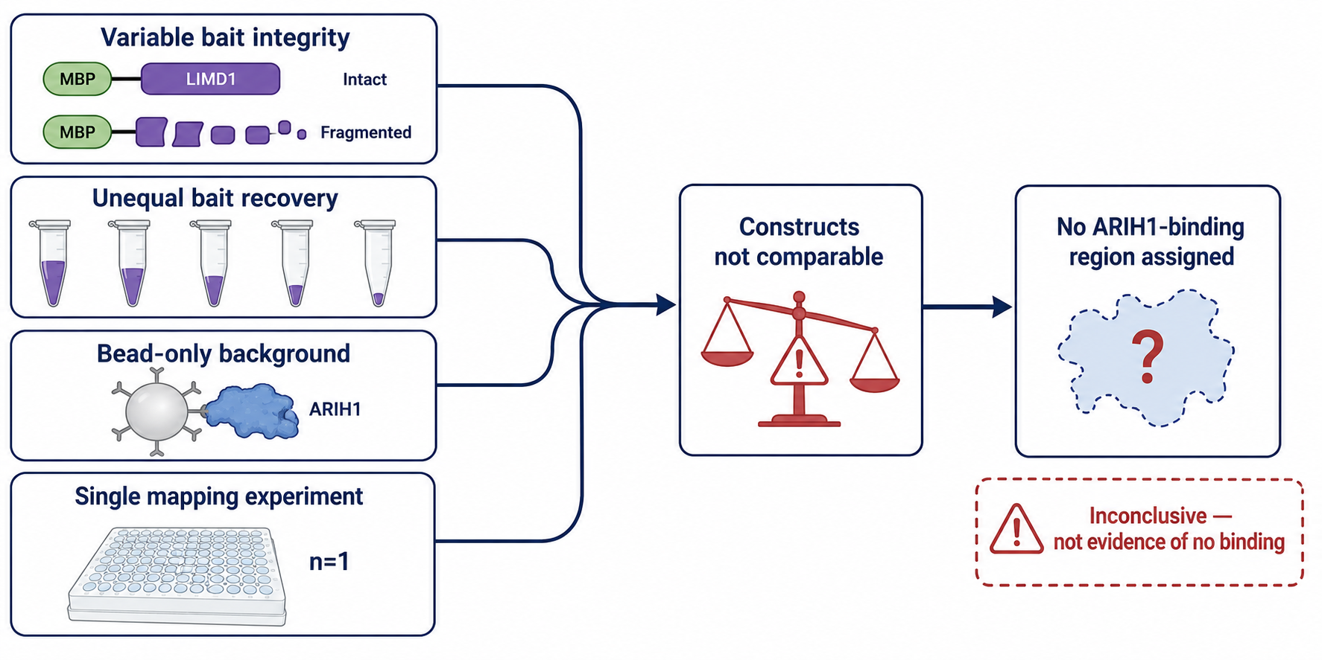
Discussion
Why the mapping result was inconclusive
Notes:
Four limitations prevented a valid regional comparison.
Both tags were at the N-terminus, so shortened proteins could retain them while losing part of LIMD1. Bait integrity was therefore uncertain. Recovery was also unequal, ARIH1 was present in the bead-only control and the experiment was performed once.
The constructs were therefore non-comparable. A weak ARIH1 signal could reflect less intact bait or background rather than deletion of a binding site.
The result is therefore inconclusive. It is not evidence that ARIH1 does not bind LIMD1.
[Sources]
Turkay, E. 2026, MSc dissertation, pages 40 to 44.

Slide 16
Conclusion and Future Directions
ESTABLISHED
• Sequence-verified LIMD1 truncation platform
• Construct-dependent purification established
• Full-length and selected fragments recovered
NOT ESTABLISHED
• No ARIH1-, AGO2- or PGAM5-binding region assigned
FUTURE DIRECTIONS
1. Confirm intact protein and molar-match bead-bound bait.
2. Add bead-only and MBP-only controls; repeat independently.
3. Reproduce full-length LIMD1-ARIH1 binding.
4. Test candidate deletions in PD-L1 ubiquitination assays.
Notes:
This project established a sequence-verified LIMD1 panel, regenerated full-length LIMD1 and showed construct-dependent expression and purification. It did not identify an ARIH1-binding region.
Next, intact protein should be confirmed and equal molar amounts of bead-bound LIMD1 should be compared. The pull-down should be repeated independently with bead-only and MBP-only controls.
Once full-length LIMD1 and ARIH1 association is reproduced, mapping can be repeated. Any candidate region should then be altered within full-length LIMD1 and tested in PD-L1 ubiquitination assays, linking the interaction to disease-relevant PD-L1 control.
[Sources]
Turkay, E. 2026, MSc dissertation, pages 42 to 47.
Shah et al. 2026, Life Science Alliance, volume 9, issue 10.

